Slide 1
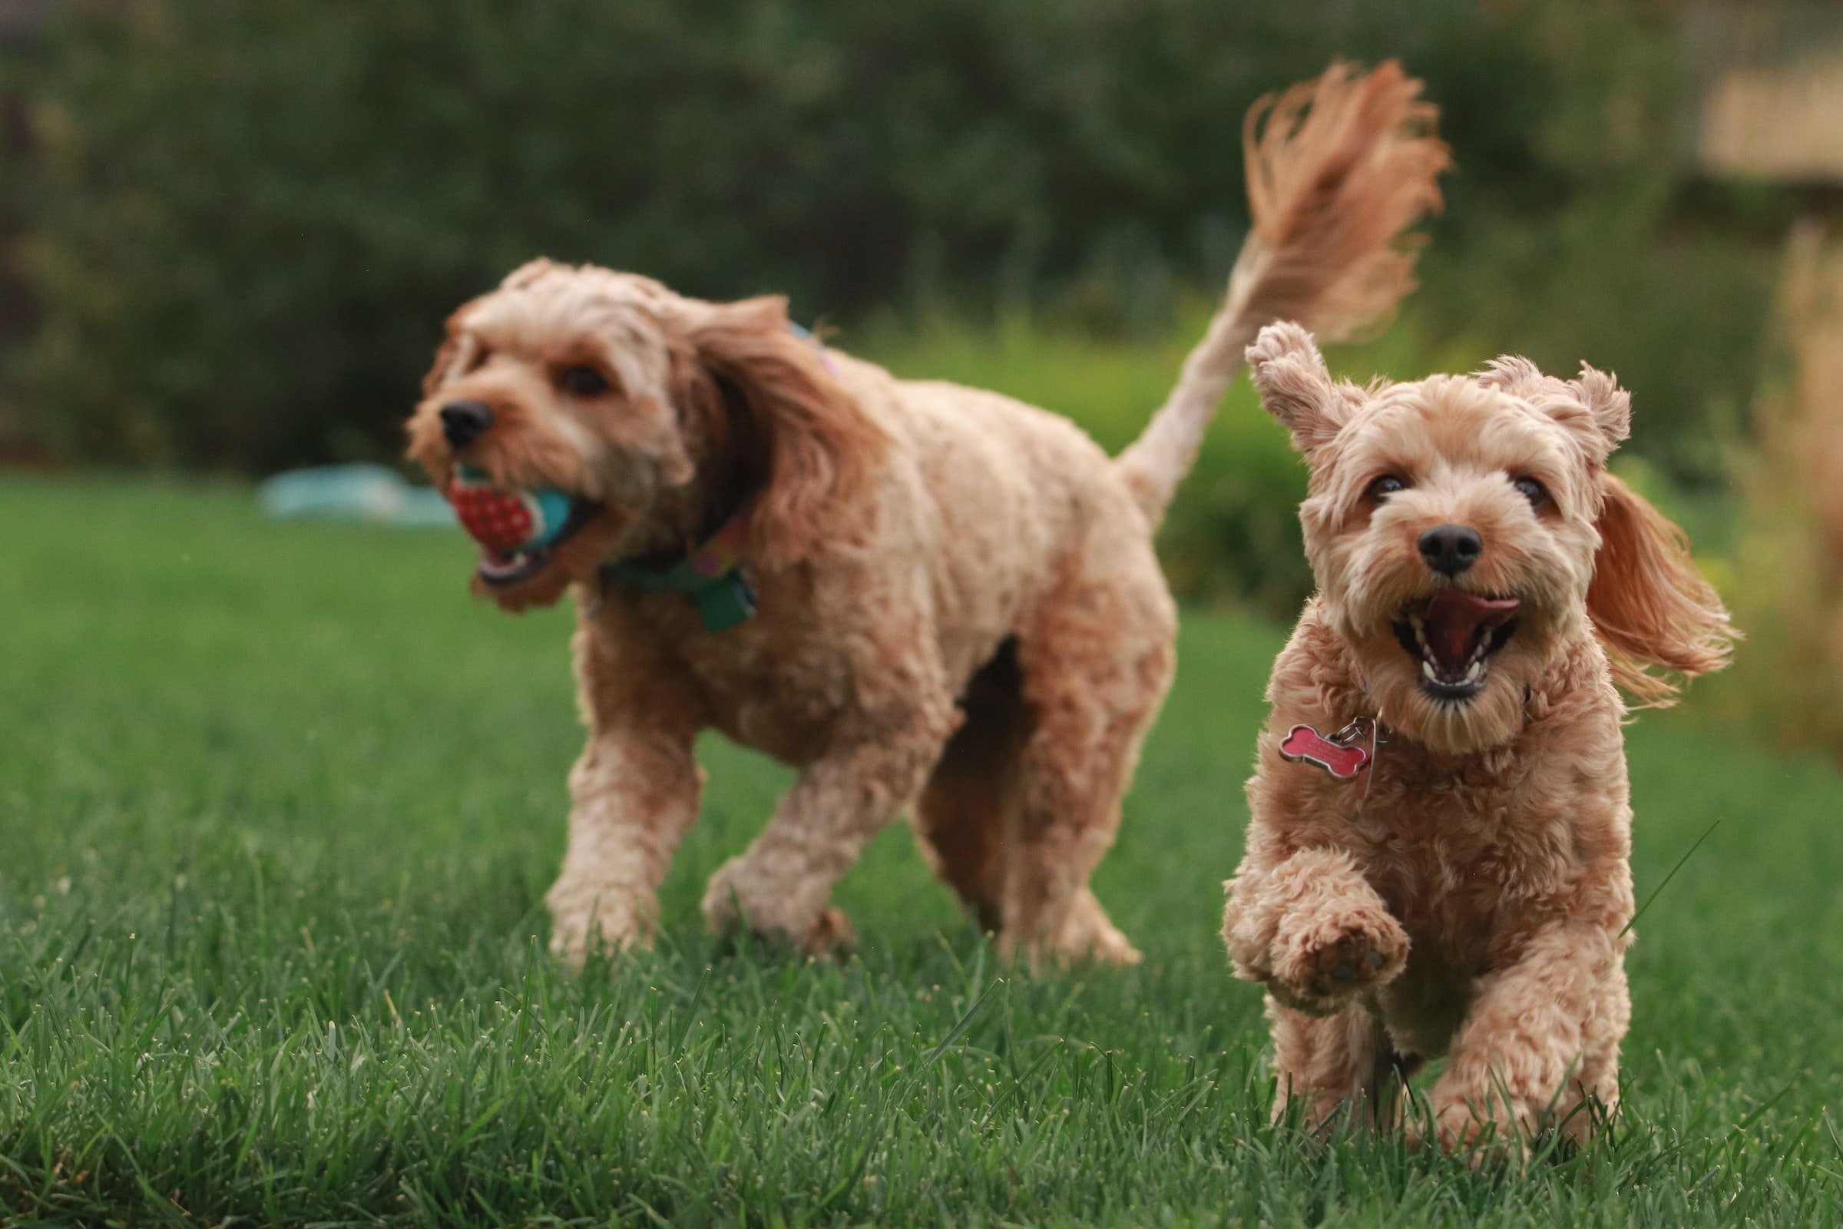
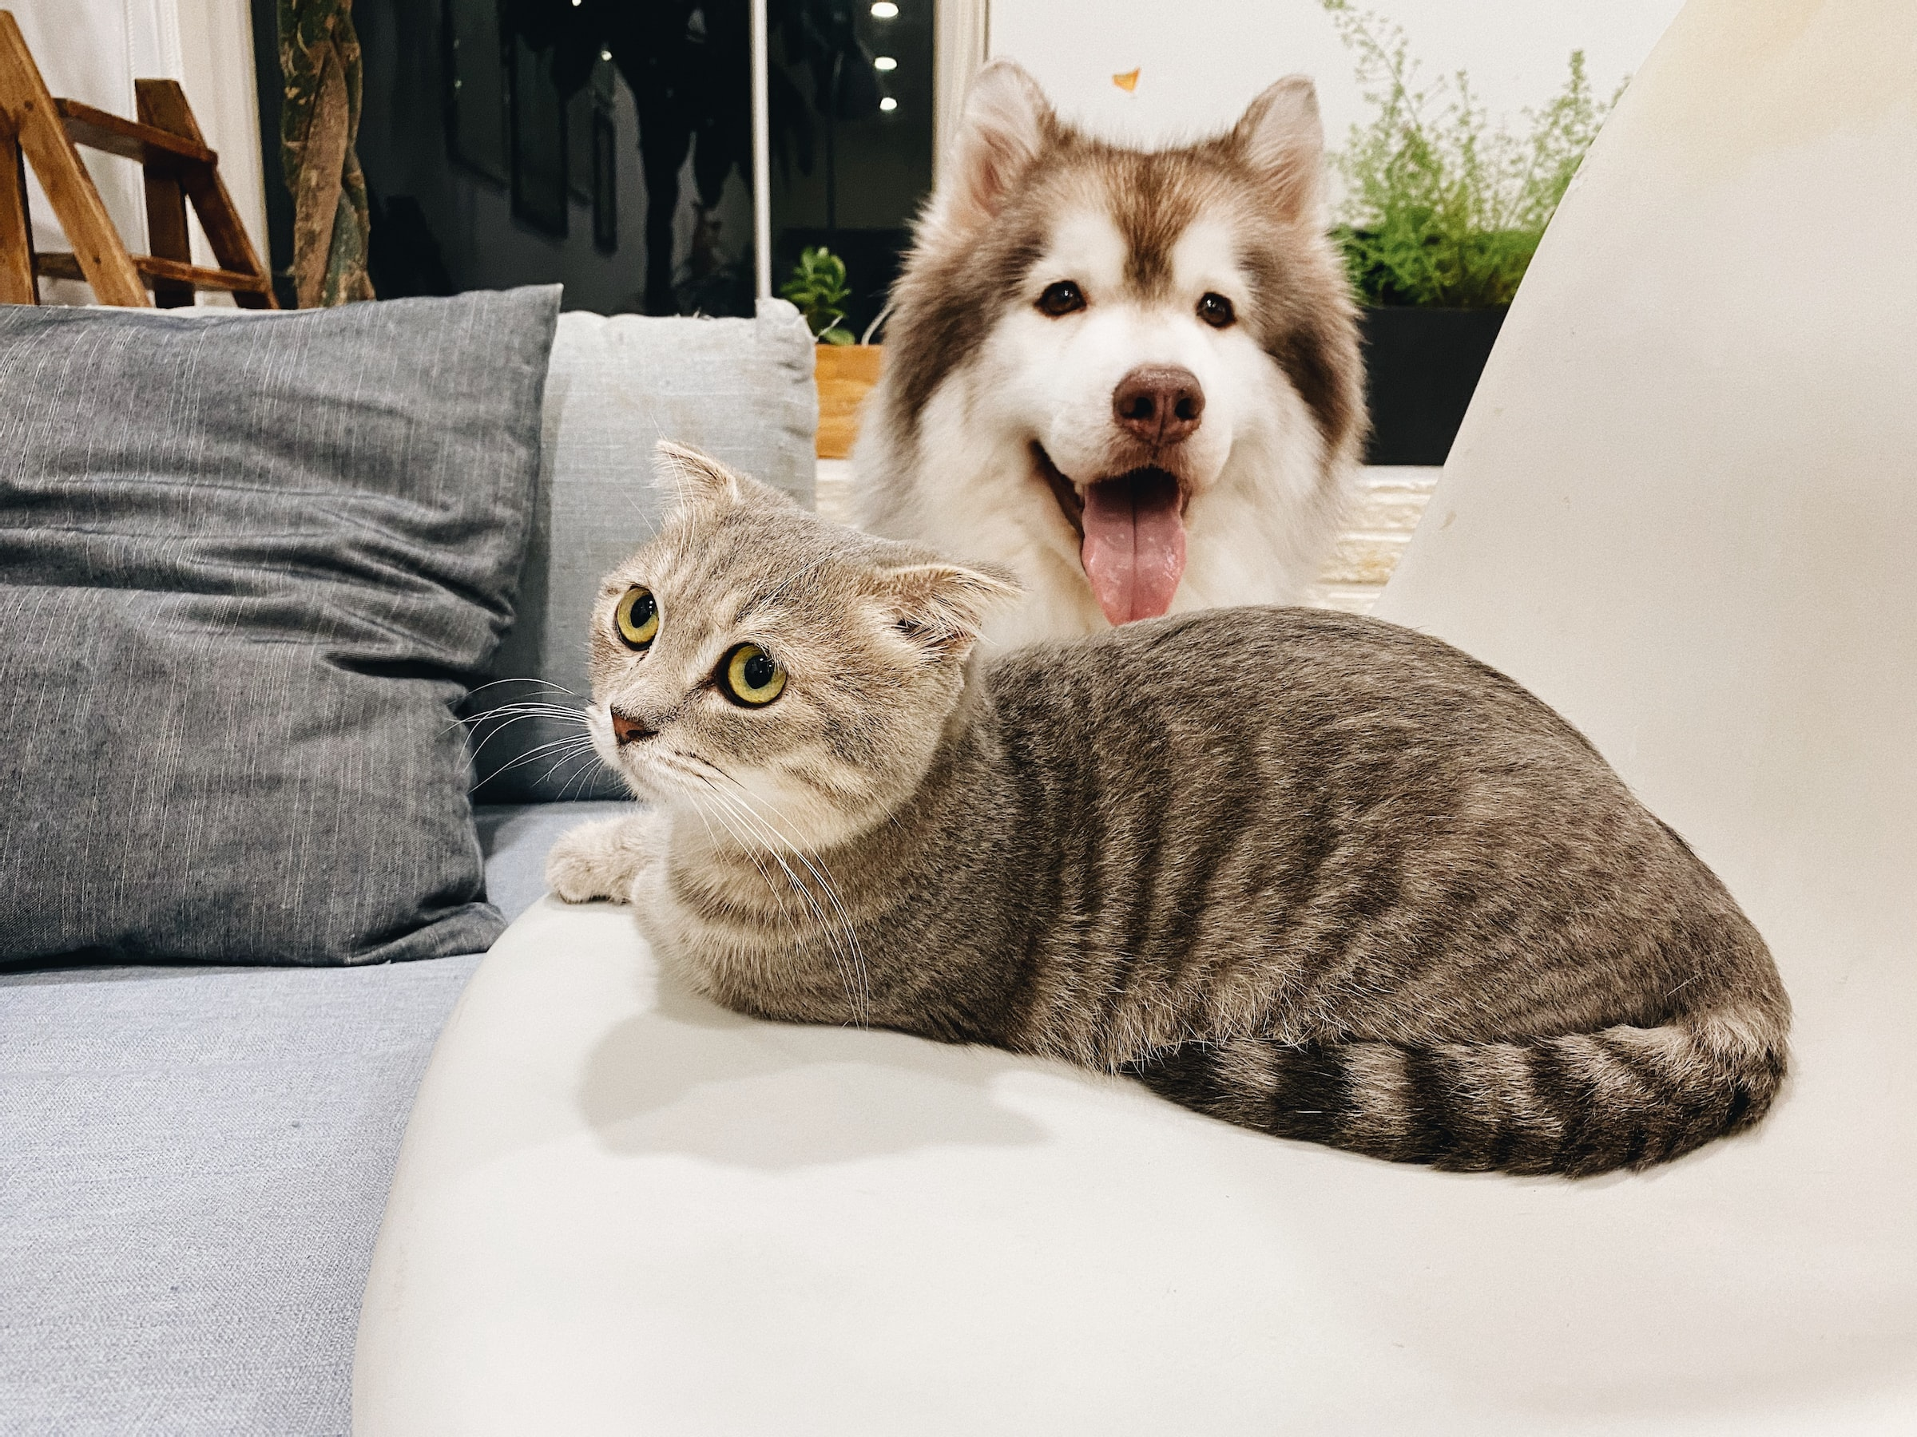


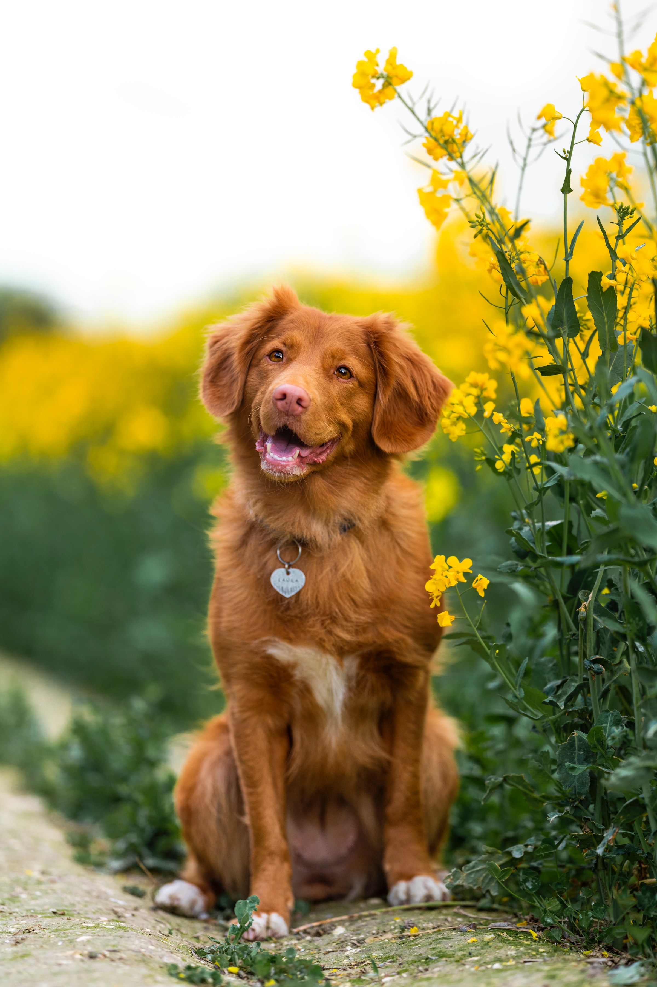
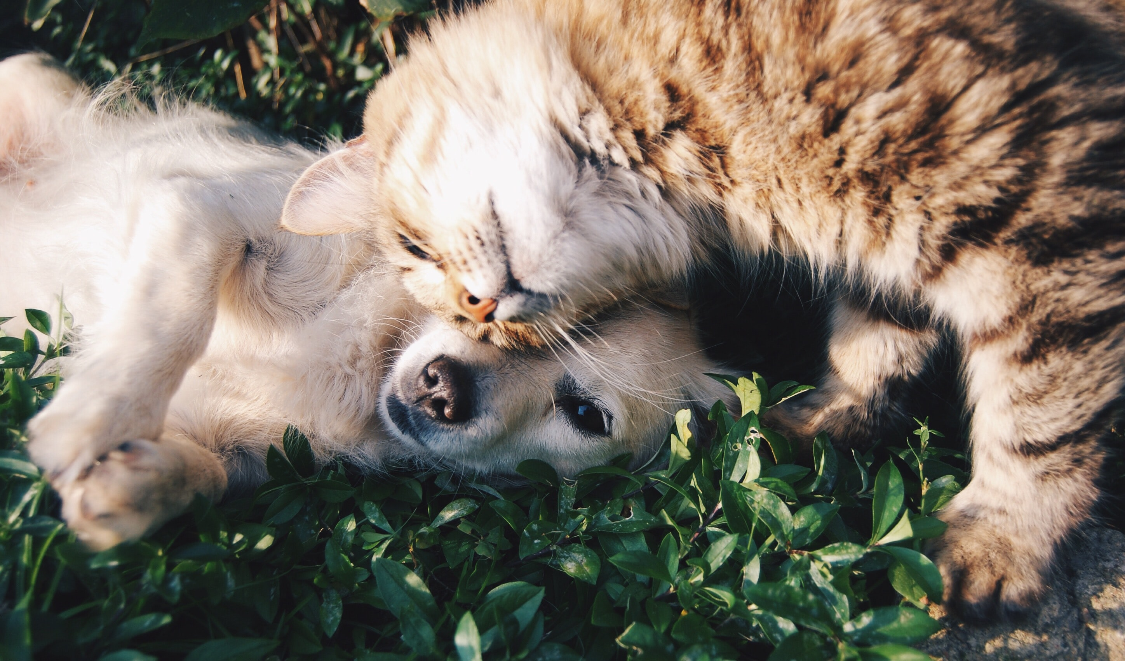
Project: Pet Analysis
Group Name: TIC {Taiwan-India-Canada}
Contributors: Zi-Ying(Sophie) Chen,
Shveta Sharma,
Alyssa Foote

Slide 2
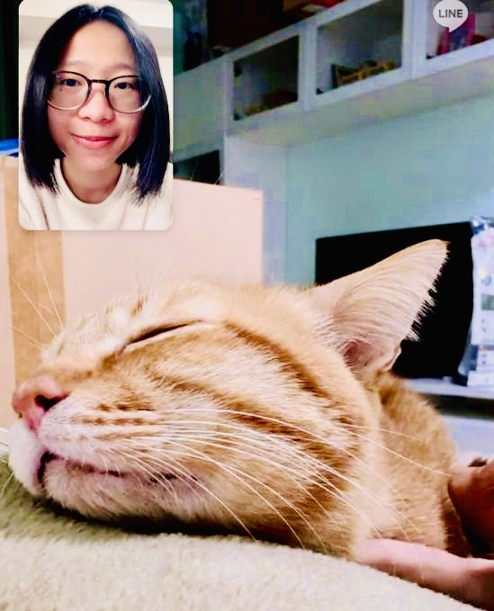
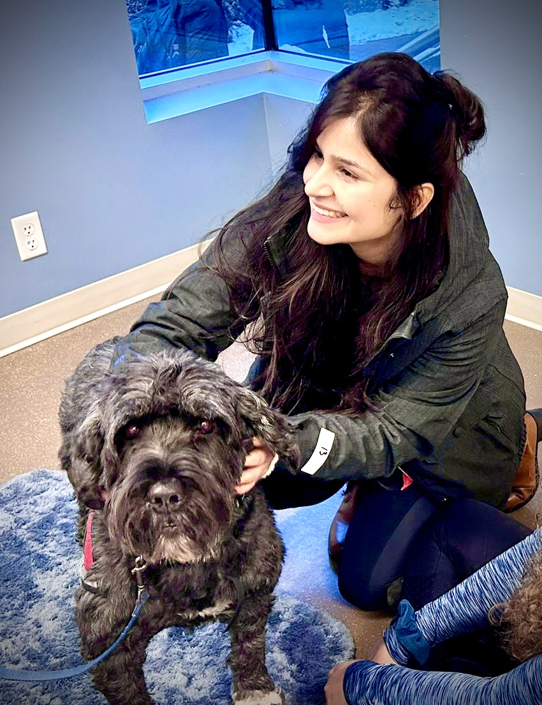
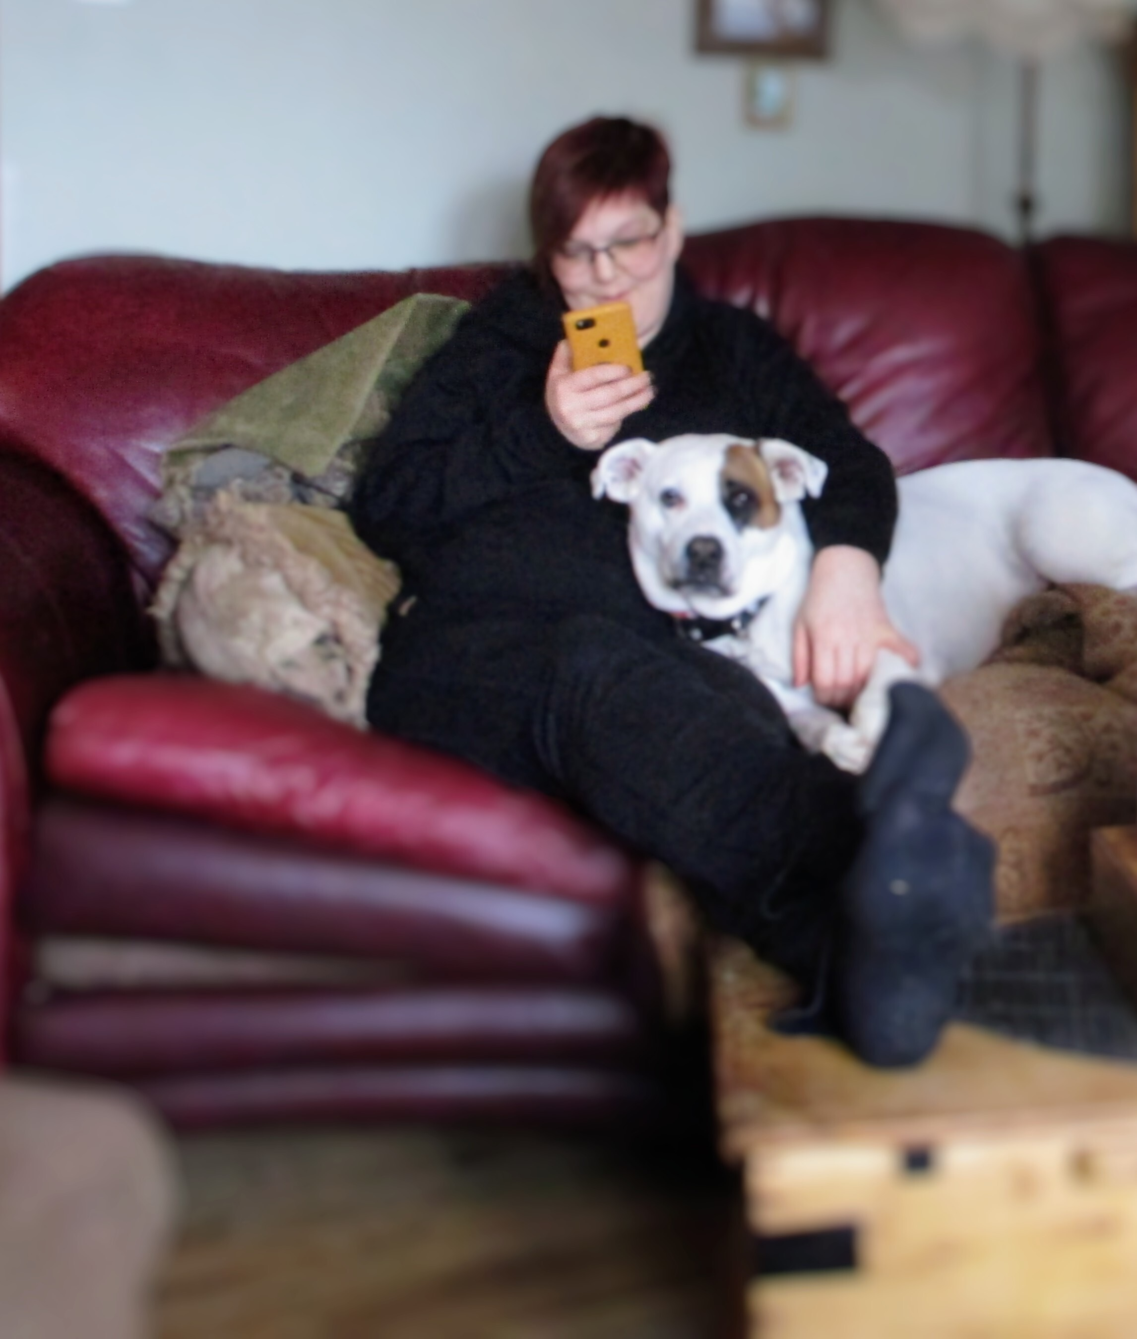

Zi-Ying(Sophie) Chen
Country: Taiwan
Loves: Bubble tea
Pet Choices: Cats
Shveta Sharma
Country: India
Loves: Coffee
Pet Choices: Dogs
Alyssa Foote
Country: Canada
Loves: Tea
Pet Choices: All Animals!!

Slide 3
Potential Usage & Users for our API
To analyze the adoptable pets from Petfinder.com
To help the researchers benefit from the basic correlation, association and exploratory data analysis for pets open for adoption.
To practice our web scraping and API building skills in lieu of becoming a better data scientist
Intended users are researchers looking for probabilities of association between different pet features and analyze Pets open for adoption.

Slide 4
Introduction
The PetAnalysis wrapper API allows you to access the exploratory analysis conducted on thousands of pets listed on Petfinder.com and various animal welfare shelters hosting these pets.
This Python-package Petanalysis contains 11 wrapper functions to get pet available data of the US. These functions process API https://api.petfinder.com/v2/organizations?page=1 to get data from shelter information and processes API https://api.petfinder.com/v2/animals?page=1 to get the animal data.
Main wrapper functions :
Get_Shelter : fetches shelter information based on postal code.
Assoc_Rules : analyses association and correlation across pet attributes.
Visualize : visualizes the insights drawn within PetFinder world.

Slide 5
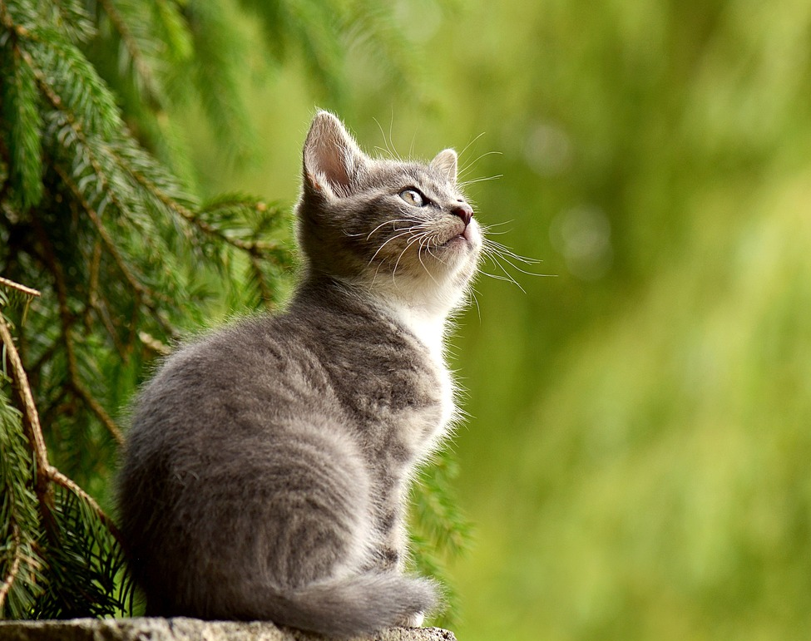
Get Shelter
This function would primarily help the user to fetch nearest shelters(within 10 miles) based on the postal code input.
The output response is comprised of the name of the shelter, phone number and website to schedule an appointment in advance, if required.
We have used latitude and longitude values across US and python’s inbuilt libraries for geo-coding to discover the nearest shelters.
The response of the function will provide shelters sorted by closest first.
We scraped data from Petfinder’s Organization API separately to built this functionality

Slide 6
Association Rules
This is the distinguishing feature designed to help the researchers or users to get an insight about the association and correlation between different features or attributes endowed by pets.
We have used Apriori algorithm to decipher the top rules that provide a minimum support, minimum confidence and a minimum value of lift with regards to pet attributes.
This function has input parameters:
Minimum support
Minimum confidence
Column for sorting rules (this can be lift, support, confidence, etc)
Count of top rules as per requirement

Slide 7
> SUPPORT : frequency of occurrence of certain attributes together. For example: We found out that a mixed breed dog generally doesn’t have a secondary coat color. This statement has a data support of over 65%. ------------------------------------------- > CONFIDENCE : likelihood of attributes or pet features being together. For example: We found out that If a pet dog is comfortable in environment with cats, we are 85% confident that it will be comfortable with children as well. -------------------------------------------- > LIFT : A lift value of larger or smaller than 1 shows positive or negative correlation/dependence between the attributes/features of pets. For example: We are getting a lift of around 3 for pet dogs (age-baby, mixed-breed, comfortable with children) to be positively correlated with having more dogs in the same household

Slide 8
Visualize
This module is designed to provide beautiful visualization of the pet attributes from the dataset of adoptable pets
User has the option to select the kind of visualization they want to opt for.
We have provisions for
Histograms
Heatmaps
We have bifurcated data by gender in visual graphs to make it easier for users

Slide 9
Technical Challenges
PetFinder.com API outputs only 20 records per page, so we have to loop in order to extract data from all pages but our user was getting locked out after 500-600 pages and unable to login again.
We tried different users to fetch close to ~20000 records for our analysis
While applying association rules using python libraries, it wasn’t as straightforward as in R.We tried various libraries like PyCaret, Apyori and Mlxtend. We created a generic wrangling function for pre-processing data and implemented On-hot encoding the attributes for it to be ingested by mlxtend library.

Slide 10
Future Work
We can extend the visualizations to incorporate interactive dashboards with more functionalities
We can apply text mining on tags to do sentiment analysis for adoptable pets.

